Slide 1

Challenge 1: AI-Driven Literature Search in Molecular Biology and Pharmacology
Team 2: Ghada Tagorti, Alessio Gamba and Akangbe Olusola

Slide 2
Methodology
A. Curation of AOP and MIE of compounds
B. Curation of relevant literature
C. Validation and Evaluation

Slide 3
Steps:
1- Collecting AOP and MIE
1- Derive the IUPAC name of compound from PubMed
2- Run IUPAC name on aopkb.oecd.org to get AOP
3- Run AOP on aopwiki.org to get MIE

Slide 4
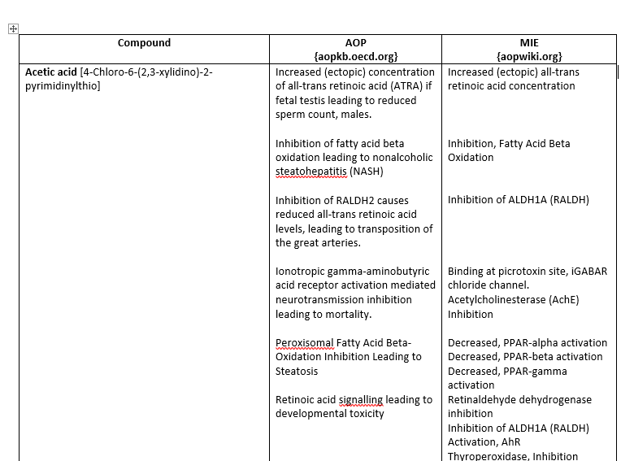
Example

Slide 5
Steps:
2- Collecting relevant literature
Use PubMed Database
Retrieve articles with keywords such as: ‘compound name’ AND ’molecular target’ OR ‘compound name’ AND ‘protein binding’
From abstract of the selected articles, we used ChatGPT to understand the mode of interaction with targets
Excel file was generated, and data were included

Slide 6
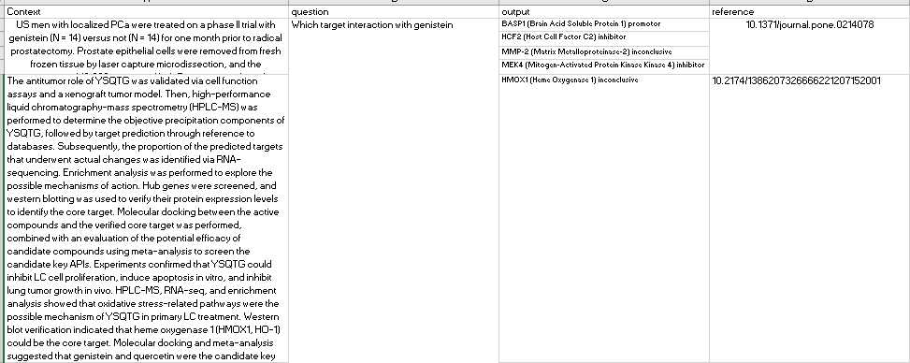
Example

Slide 7
Steps:
3- Sorting data
Building code using ChatGPT to convert Excel file to JSON string format to use it for fine-tuning
Code was running in Google Collaboratory

Slide 8
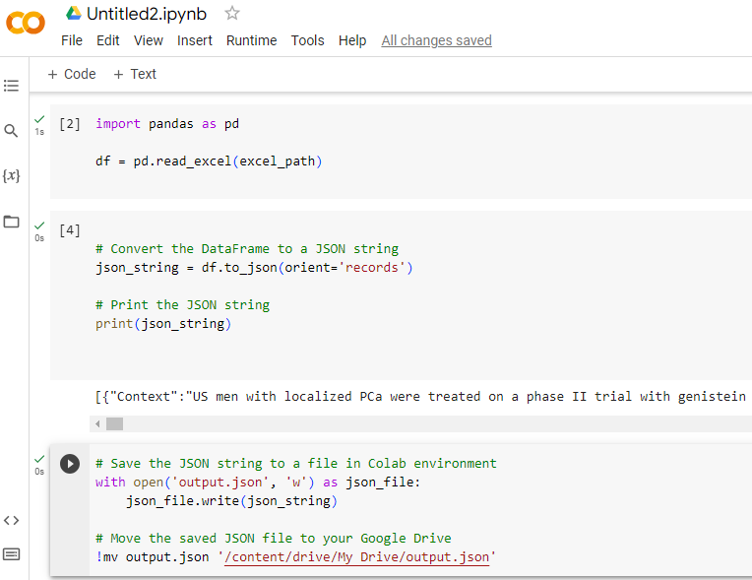
Example of the code

Slide 9
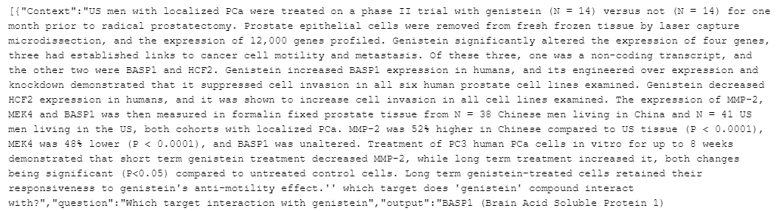
Example of JSON file

Slide 10
Steps:
4- Validation and Evaluation
Choose model for fine-tuning
Database will be used to query and Fine-tune AI approach’s performance

Slide 11
Challenges:
Some compounds had no AOP, while some that had did not have MIE
Other compounds had no records of AOP or MIE on the database
Few data were available for the last 5 years articles
Some compounds have more data compared to others
Screening abstract manually was time consuming task, finding more AI tools to ensure screening is recommended
Some abstract didn’t include the appropriate answer (interaction not clear), reading full text should be followed

Slide 12
Next Steps:
Proceed with the ongoing data acquisition for the remaining compounds.
Choosing model to perform fine-tuning.
Comparing (Evaluating) AI approach performance with that of our curated Database.

